Slide 1





WordPress Basics
Course Introduction
WordPress
SoftUni Team
Technical Trainers
Software University
http://softuni.bg

Slide 2



Table of Contents
Web Basics Module
Course Program
Trainers Team
Course Schedule
Exams and Evaluation
Learning Resources

Slide 3
Have a Question?
sli.do #web-basics

Slide 4







SoftUni Diamond Partners

Slide 5

Web Basics Module @ SoftUni
4 Months Web Front-End Basics Training

Slide 6
Web Basics: Module Goals
4 months intensive front-end
2 times weekly, lots of live coding and exercises
Part I – Web Fundamentals (HTML + CSS)
HTML, document structure, CSS, selectors, rules, presentation and positioning, landing pages, forms, responsive design, transitions, animations, practical exam
Part II – WordPress Basics
CMS systems, WordPress, hosting, install and configure, create / edit content, themes, plugins, custom themes, practical project

Slide 7
Web Basics Module at SoftUni – Timeline
19-May-2017
20-July-2017
September-2017
Web Fundamentals (HTML & CSS)
Lessons + exercises + team work + exam
9 weeks * 2 times / week
6 credits
Start: 19-May-2017
Final exam: 16-July-2017
WordPress Basics
Lessons + exercises + final project
6 weeks * 2 times / week
3 credits
Start: 20-July-2017
Project Defense: 19-August-2017
Web Basics Re-Take Exams
Second week of September 2017

Slide 8
Professions @ SoftUni
Programming Basics
Java
Fund.
Java
DB
Java
Web
JS Core
Web
Basics
Tech Module
C#
Fund.
C#
DB
C#
Web
JS Core
Web
Basics
Programming Fundamentals
JS Core
MEAN
Stack
Web
Basics
Software Technologies
PHP
Web
Web
Basics
JS Core
https://softuni.bg/curriculum
https://softuni.bg/trainings/courses

Slide 9



WordPress Basics
Course Objectives & Program

Slide 10
WordPress Basics – Course Topics
WordPress Intro: Installation, Domains, Hosting, Edit Content
Popular WP Themes, Visual Editors
WP Plugins – Forms, Galleries, Forums, eCommerce, …
Creating a Custom WP Theme with PHP and HTML+CSS
Workshop: Building a Real Life WP Site
Consulting Day – Students Get Help with Their Projects
Public Project Defenses

Slide 11

The Trainers Team

Slide 12

Trainers Team
Nikolay Bankin
Top performing student from the Software University (2014)
4 years of programming experience mainly with Java, PHP, HTML, CSS and JavaScript
Teacher at TUES

Slide 13

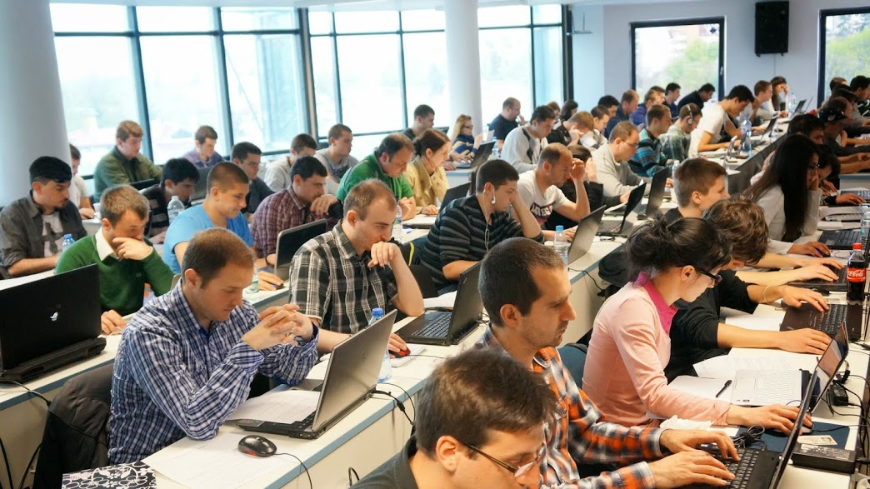
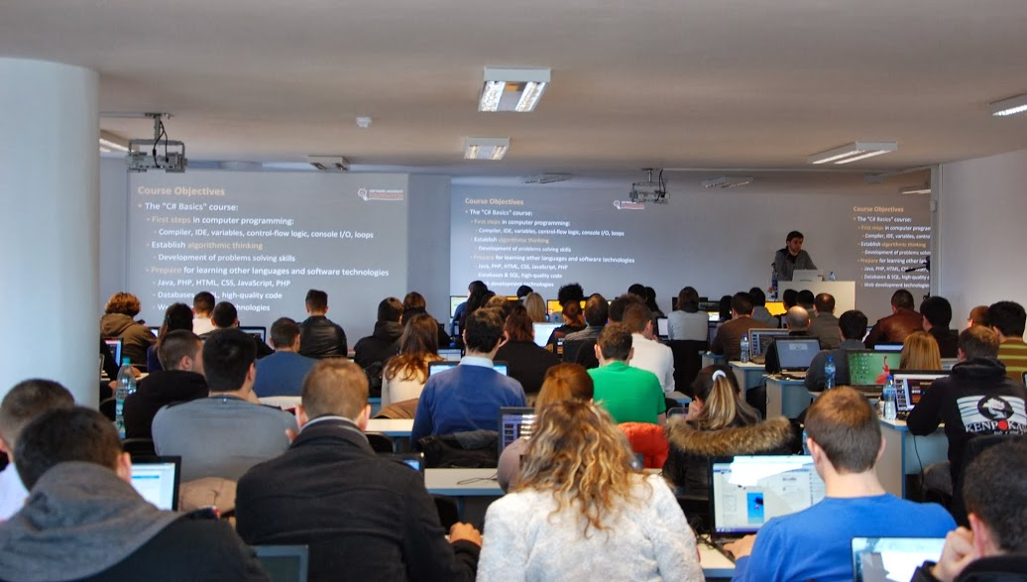
Teaching Assistants
Teaching assistants
Top students from SoftUni

Slide 14

WordPress Basics: More Details
Duration, Languages, Technologies

Slide 15


Training Duration – Wordpress Basics
Lessons: ~ 16 hours (onsite + videos)
Practical exercises (in class): ~ 26 hours
Homework: ~ 10-20 hours
Schedule: 20 July – 19 August 2017
Project Defenses: 19 August 2017

Slide 16
Why WordPress?
WordPress is the world's #1 CMS (content management system)
WP powers 30% of all Web sites in Internet (July 2017)
70+ millions web sites run WordPress (July 2017)
https://trends.builtwith.com/cms
Free, open source software
WordPress Foundation: https://wordpress.org
Easy to use / customize / add functionalities
Thousands of themes and plugins

Slide 17



Why English?
Why the slides are in English?
English is the native language of the software engineers
Specific terminology should be in English
Translations are inaccurate and funny
Just learn English!
No excuses

Slide 18
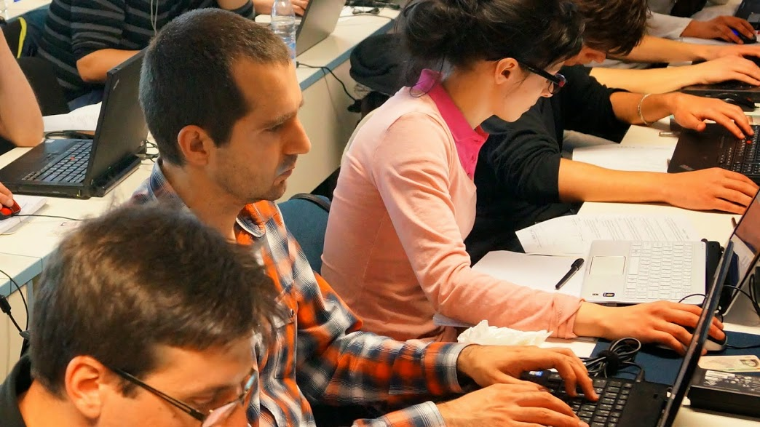


WordPress Basics
Evaluation Criteria

Slide 19



Scoring System for the “WordPress Basics"
Practical project – 90%
Homework – 10%
Forum activity – bonus up to 10%

Slide 20
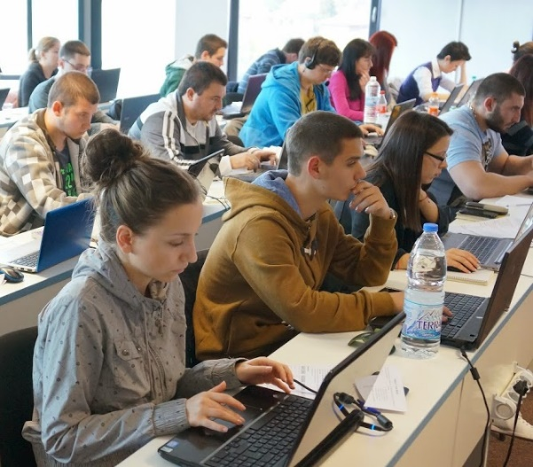

WordPress Basics Practical Project
Practical WordPress Project
Build a modern WordPress Web Site
Live project on the Web
Modern responsive theme
Custom theme is also allowed
Meaningful content + good UX
Well organized navigation
Correct use of plugins

Slide 21
Sample Practical Projects
SoftUni Tech Fest – http://techfest.softuni.bg
Nakov's Blog – http://www.nakov.com
Intro Programming Books – http://www.introprogramming.info
Together in Class – https://zaednovchas.bg
CourseLab – http://courselab.net
DEV.BG – http://dev.bg
Association of Software EngineersSE – http://www.ase.bg
2DoIT Conference – http://2doit.co/agile/

Slide 22

Homework Assignments
Doing your homework is very important!
WordPress can only be learned through a lot of practice!
You should practice code every day!
Each lesson is followed by a few exercises
Try to solve them in class
The rest are your homework
Homework assignments are due in 6 days after each lesson
Submission are accepted through: softuni.bg

Slide 23










Resources
What We Need Additionally?

Slide 24

Course Web Site & Forums
The Wordpress Basics official course web site:
Join for the "Software University Forum":
Discuss the course exercises with your colleagues
Find solutions for all course exercises
Share source code / discuss ideas / help each other
https://softuni.bg/courses/wordpress-basics
https://softuni.bg/forum/categories/102/wordpress

Slide 25
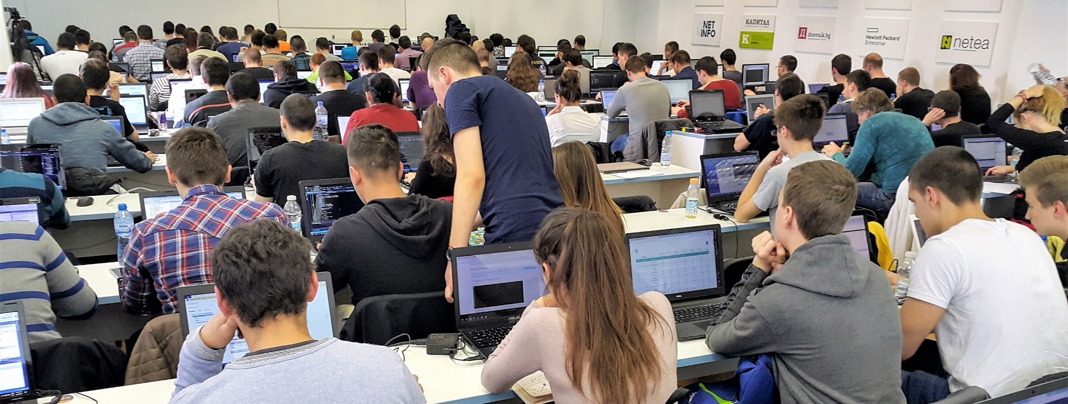
Facebook Group
The Wordpress Basics official Facebook group
facebook.com/groups/softuni.web.basics.may.2017

Slide 26



Slides and Videos
All slides, videos, homework assignments, projects and other resources are open content, available for free
Visit the course web site to access the course resources

Slide 27

WordPress Tutorials
Udemy WordPress Tutorial
https://blog.udemy.com/wordpress-tutorial/
WP Course @ Tutorials Point
https://www.tutorialspoint.com/wordpress
Smashing Magazine WP Tutorial
https://www.smashingmagazine.com/2016/02/beginners-guide-creating-wordpress-website/

Slide 28

Software University Learning System (SULS)
Software University Learning System (SULS)
www.softuni.bg
Important resource for students
Homework submissions
Homework check-up
Exams and results
Reports about your progress
…

Slide 29


Recommended Software
We recommend XAMPP to run a local WordPress instance
We recommend purchasing your own hosting + domain with a discount
Or use free hosting + domain (for educational purposes only)
http://freesubdomain.org, https://www.000webhost.com, …

Slide 30


Summary
The "WordPress Basics" course teaches
Creating modern WordPress Web Sites
Training curriculum
WP installation, domains, hosting, creating content, WP themes, WP plugins, custom themes
Practical project
Build your own WordPress Web site
Learning resources
Slides, videos, tutorials, forum
WordPress

Slide 31
WordPress Basics – Course Introduction
https://softuni.bg/courses/wordpress-basics

Slide 32

License
This course (slides, examples, demos, videos, homework, etc.) is licensed under the "Creative Commons Attribution-NonCommercial-ShareAlike 4.0 International" license

Slide 33





Free Trainings @ Software University
Software University – High-Quality Education, Profession and Job for Software Developers
softuni.bg
Software University Foundation
softuni.org
Software University @ Facebook
facebook.com/SoftwareUniversity
Software University Forums
softuni.bg/forum

